Slide 1
Proctoring System: Recommendations and Analysis

Slide 2

Introduction
Online video interviews have become increasingly popular due to their convenience and cost-effectiveness. However, with this rise in popularity comes the risk of malpractice, such as cheating or impersonation, which can compromise the integrity of the interview process.
To prevent malpractice during online video interviews, proctoring measures and techniques have been developed to ensure that candidates are who they claim to be and that they are not engaging in any unethical behavior.

Slide 3

Identity Verification
One of the most important proctoring measures for online video interviews is identity verification. This involves verifying the candidate's identity through various means, such as requiring them to show a government-issued ID, taking a photo of themselves, or answering personal questions.
Some platforms may also use biometric authentication, such as facial recognition technology, to verify the candidate's identity and prevent impersonation.

Slide 4

Face Detection
Another proctoring measure that can be used during online video interviews is face detection. This technique involves using software to monitor the candidate's face and detect any suspicious activity. For example, if the candidate looks away from the screen for an extended period or if their face is partially covered, the software can alert the interviewer.
Face detection can also be used to verify the identity of the candidate using facial recognition technology. This technique works by comparing the live video feed of the interviewee with a pre-registered image which is their ID or passport photo. If there is a mismatch, the proctoring software will flag it as a potential malpractice.

Slide 5

Cheat Detection
Cheat detection is a proctoring technique that monitors the interviewee's computer screen for any unauthorized activity such as opening a new tab or window. The candidate's web browser can also be locked during the interview, preventing them from accessing unauthorized websites or searching for answers online.
This technique also monitors the interviewee's keystrokes and mouse movements to detect any suspicious behavior that may indicate cheating.

Slide 6

Cheat Detection
The candidate's ability to share their screen can be restricted during the interview, preventing them from using external resources or displaying unauthorized content.
The software can detect any suspicious activity, such as multiple faces or voices or changes in the lighting or background. If any cheating is detected, the proctoring software can immediately alert the interviewer, who can then take appropriate action.

Slide 7
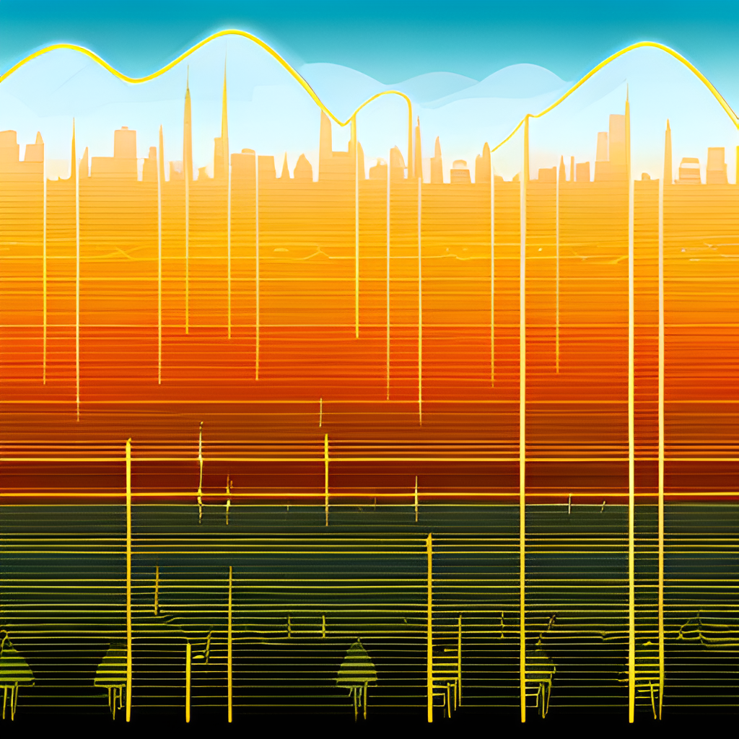
Noise Detection
Noise detection is a proctoring technique that uses audio recognition technology to detect any background noise or suspicious sounds during the interview.
This technique works by comparing the audio feed of the interviewee with a pre-registered ambient noise level. If there is a significant deviation, the proctoring software will flag it as a potential malpractice.

Slide 8

Rotate Camera
Rotate camera is a proctoring technique that monitors the interviewee's webcam to ensure that they are not using any external aids such as notes or books.
Some candidates may try to cheat during online video interviews by having someone else sit in front of the camera while they answer the questions. To prevent this, proctoring software can be used to monitor the candidate's camera and detect any suspicious activity.

Slide 9

Rotate Camera
One technique that can be used is to require the candidate to rotate their camera 360 degrees before the interview begins. This can help to ensure that there is no one else in the room and that the candidate is alone during the interview.
Proctoring systems can monitor the camera feed and detect any attempts to rotate or move the camera. This ensures that the candidate maintains a consistent position and doesn't attempt to hide or share information off-screen.

Slide 10
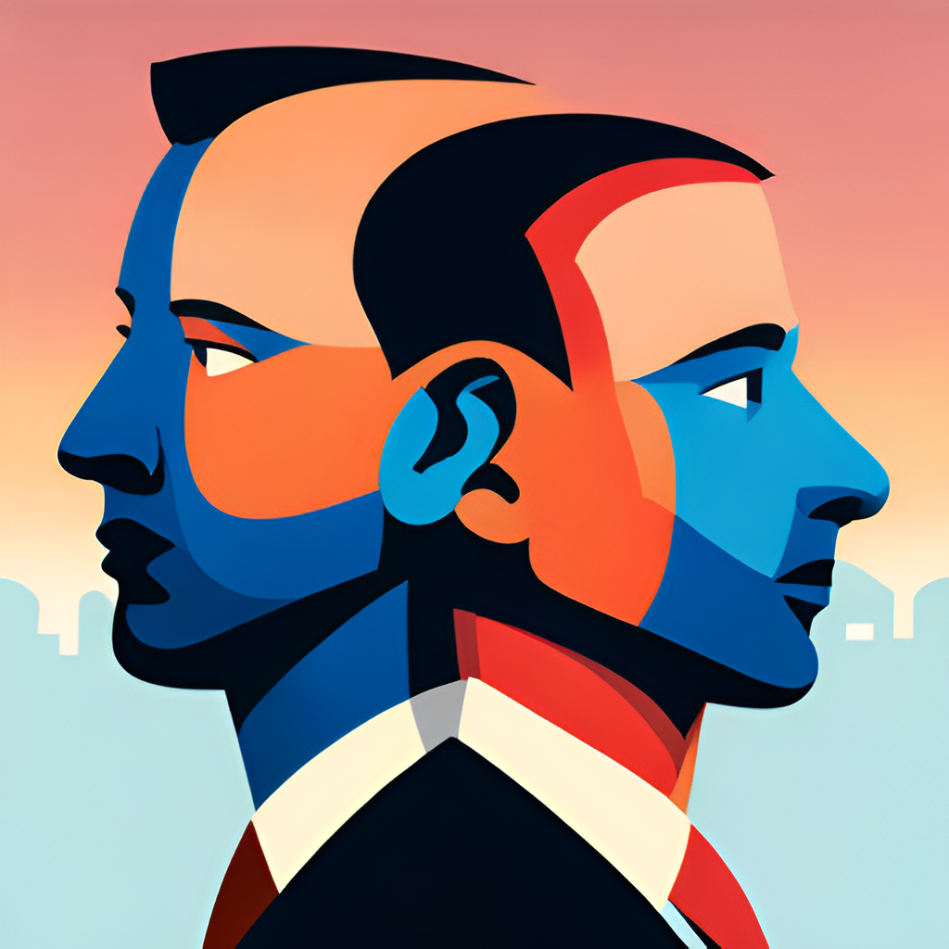
Other Violations
Apart from cheating, there are other violations that may occur during online video interviews, such as inappropriate behavior or language. To prevent these violations, proctoring software can be used to monitor the candidate's activity during the interview.
The software can detect any suspicious activity, such as inappropriate gestures or language, and alert the interviewer. If any violations are detected, the interviewer can take appropriate action, such as terminating the interview or reporting the candidate to the relevant authorities.

Slide 11

Conclusion
In conclusion, proctoring measures and techniques are essential in preventing malpractices in online interviews. By combining various techniques such as face detection, cheat detection, noise detection, and rotate camera, a comprehensive proctoring software can be developed.
It is important to note that while these techniques can prevent malpractices, they should not be used to invade the interviewee's privacy. The proctoring software should only monitor the interviewee during the interview and not outside of it.

